Slide 1
Can AI Simulations reliably reproduce human consumer responses?
BEAUTY & WELLBEING
Assessing Human-AI behavioral fidelity across held-out response pairs
Pavankumar Umesh Managoli
21/09/2026

Slide 2
Why evaluating AI consumer simulations matters?
The Opportunity
Faster consumer research
Lower cost than large-scale surveys
Rapid testing of ideas and concepts
The Challenge
Human-like responses do not necessarily mean human-like behavior
Similar wording can hide important differences in preferences and motivations
Leadership needs a reliable measure of trust
The Objective
Assess how closely AI simulations match real consumers
Identify where simulations succeed and fail
Define appropriate business use cases and guardrail

Slide 3
How Is the Evaluation Conducted?
Real Consumer Response
AI Simulation Response
Automated Evaluation
Human Evaluation
Final Result
G-Eval
Claim Alignment
NLI Check
Semantic Similarity
Human Evaluation + Automated Evaluation

Slide 4
Why move beyond text similarity for simulation evaluation?
Limitations of Traditional Methods
Captures semantic meaning
Text Similarity
Advantages of Proposed Framework
Measures wording overlap
Misses underlying reasoning
Human Review
Subjective and inconsistent
Difficult to scale
Single-Metric Evaluation
Captures only one dimension of behaviour
Oversimplifies complex human responses
Evaluates preferences and motivations
Produces transparent and interpretable evidences
Enables comparison across simulations
Assesses decision-making logic

Slide 5
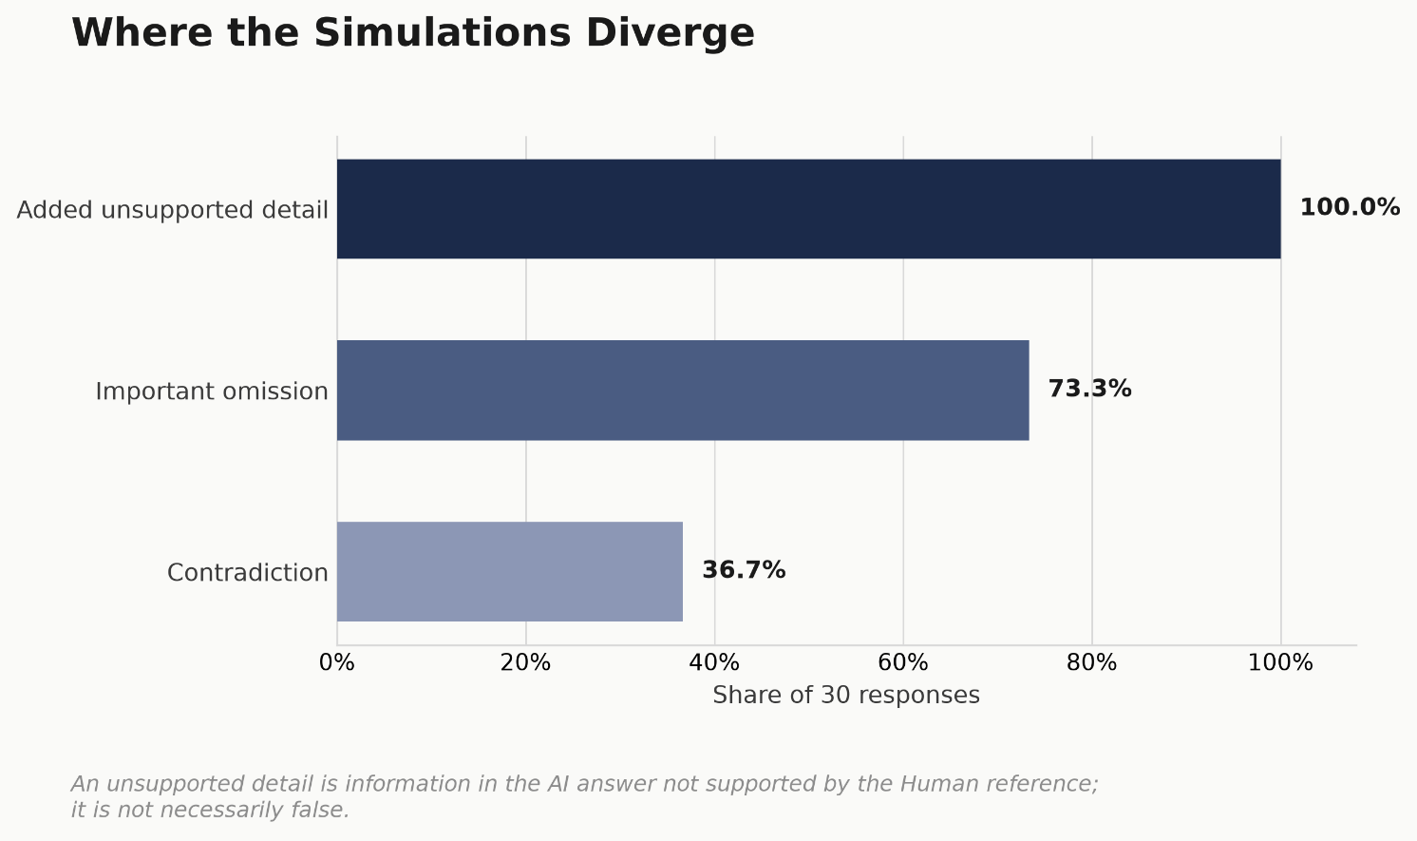
What does the evidence tell us about simulation fidelity?
2.63 / 5
Automated Match Score
2.53 / 5
Human-Reviewed Match Score
73.3%
Important omission
36.7%
Contradiction
ρ ≈ 0.82 Automated–Human alignment

Slide 6
Thank You

